Slide 1

Consumer Goods Ad hoc Insights SQL Project
Presented By: Sai Dhanush

Slide 2
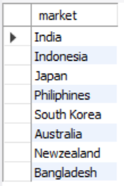
Request 1
Provide the list of markets in which customer "Atliq Exclusive" operates its business in the APAC region. OUTPUT:

Slide 3

Request 2
What is the percentage of unique product increase in 2021 vs. 2020?
The final output contains these fields: unique_products_2020, unique_products_202, percentage_chg
Output:

Slide 4
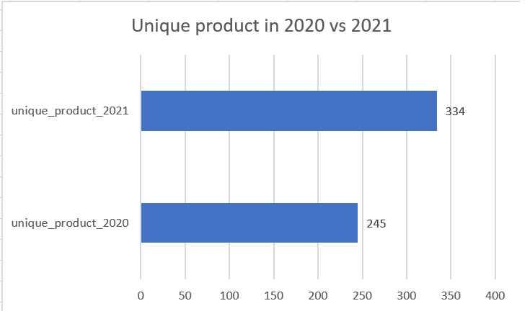
Conversion of output to visual
Insights
Their was an increase of 36% in unique product for the year 2021 as compared to 2020.
Total 89 unique product were added in the year 2021

Slide 5
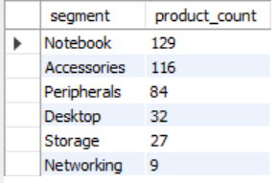
Request 3
Provide a report with all the unique product counts for each segment and sort them in descending order of product counts.
The final output contains 2 fields: segment, product_count
Output:

Slide 6
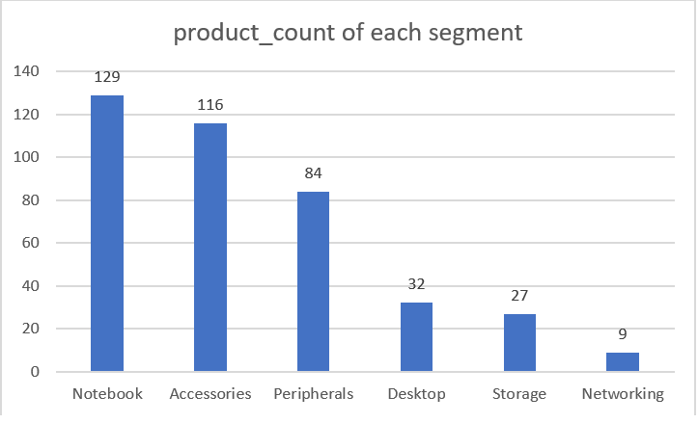
Conversion of output to visual
Insights
Notebook segment has the highest product count with 129 products followed by accessories with 116 products and networking segment has the lowest product count with only 9 products.
Desktop, storage and networking segments need immediate attention in terms of innovation as there has been almost no growth in these segments

Slide 7
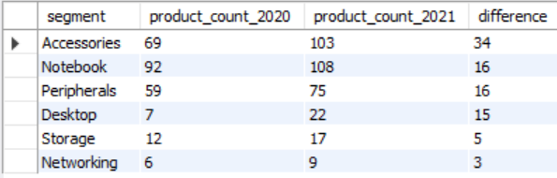
Request 4
Follow-up: Which segment had the most increase in unique products in 2021 vs 2020? The final output contains these fields: segment, product_count_2020, product_count_2021, difference b/w product_count_2021 and product_count 2020
Output:

Slide 8
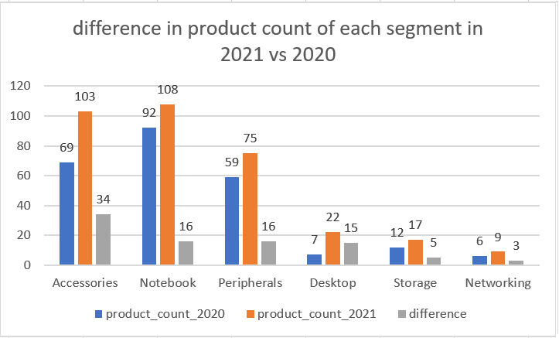
Conversion of output to visual
Insights
accessories segment had the highest increase in unique products in 2021, followed by notebook segment.
Networking segment had the least increase in unique products.

Slide 9

Request 5
Get the products that have the highest and lowest manufacturing costs. The final output should contain these fields: product_code, product, manufacturing_cost
Output:
INSIGHTS: Aq home allin gen 2 has the highest manufacturing cost and aq master wired x1 Ms has the lowest manufacturing cost

Slide 10
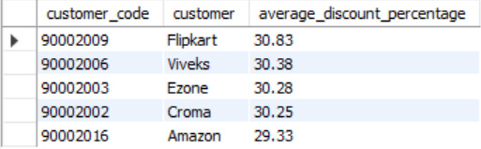
Request 6
Generate a report which contains the top 5 customers who received an average high pre_invoice_discount_pct for the fiscal year 2021 and in the Indian market. The final output contains these fields: customer_code, customer, average_discount_percentage
Output:

Slide 11
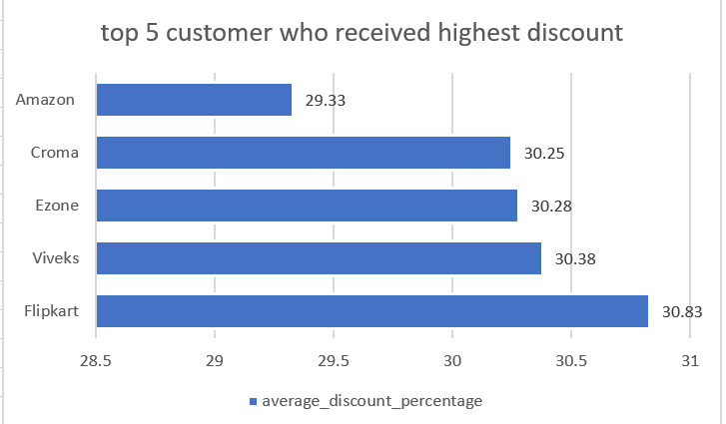
Conversion of output to visual
Insights
Flipkart received the highest average discount which is 30.83% and amazon received the lowest average discount of 29.33% among our top 5 customers in the fiscal year 2021.

Slide 12
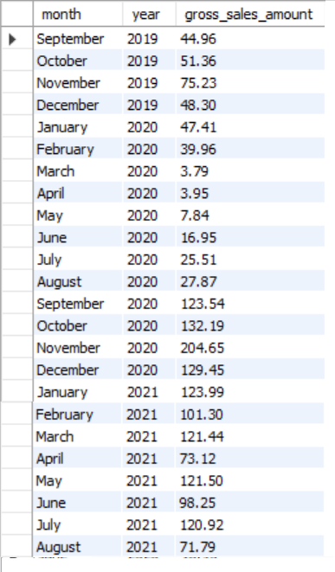
Request 7 output:
Get the complete report of the Gross sales amount for the customer “Atliq Exclusive” for each month. This analysis helps to get an idea of low and high-performing months and take strategic decisions. The final report contains these columns: Month Year , Gross sales Amount

Slide 13
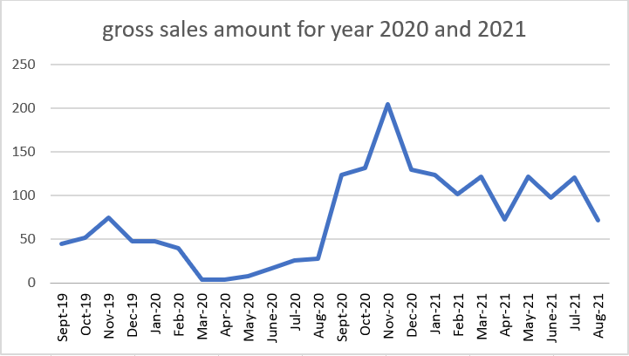
Conversion of output to visual
Insights
Nov 2020 had the highest gross sales and the reason was due to Diwali sale
the lowest gross sales was during march 2020.
Comparing fiscal year 2020 and 2021, gross sales increased tremendously in 2021 with the highest gross sale amount of 20 million dollars.

Slide 14
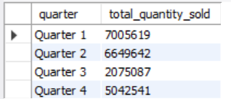
Request 8
In which quarter of 2020, got the maximum total_sold_quantity? The final output contains these fields sorted by the total_sold_quantity: Quarter, total_sold_quantity
Output:

Slide 15
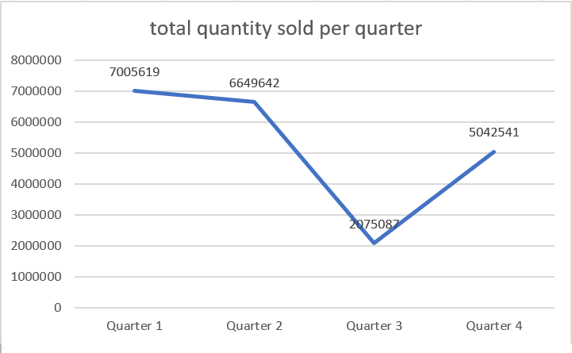
Conversion of output to visual
Insights
Quarter 1 which consists of months September, November and December had the highest quantities sold for the fiscal year 2020. the reason could be Diwali festival during the November month.
Quarter 3 had the least sold quantities for the fiscal year 2020 but we had a good recovery in quarter 4.

Slide 16
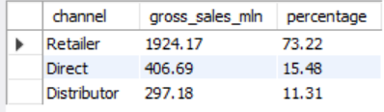
Request 9
Which channel helped to bring more gross sales in the fiscal year 2021 and the percentage of contribution? The final output contains these fields: channel, gross_sales_mln, percentage
Output:

Slide 17
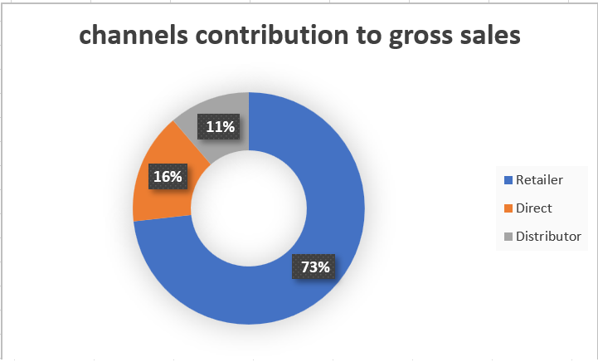
Conversion of output to visual
Insights
Retailer channel contributed the highest to gross sales, which is 73% more than the other 2 channels.
Direct channel contributed 16% and distributor channel 11% to the gross sales.

Slide 18
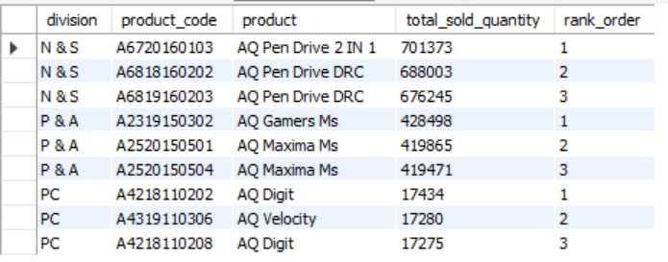
Request 10
Get the Top 3 products in each division that have a high total_sold_quantity in the fiscal_year 2021? The final output contains these fields: division
product_code, Product, total_sold_quantity, rank_order
Output:

Slide 19
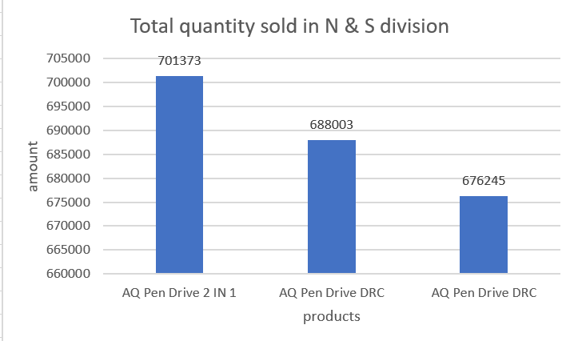
Conversion of output to visual
Insights
In network & storage division the top 3 products are pen drives of different categories.
The sales of these pen drives are more than the sales of any products in the other categories.
The combined sales of these 3 products are more than 2 million dollars.

Slide 20
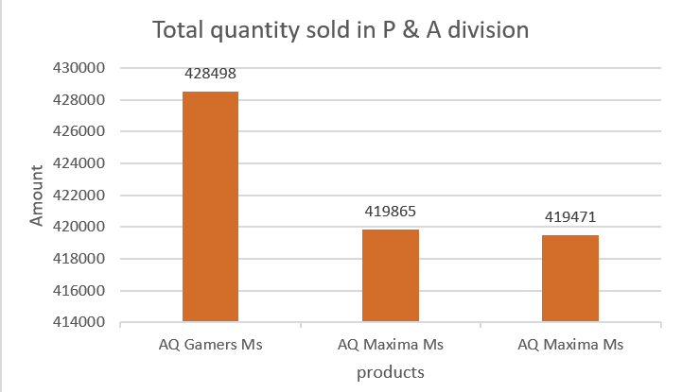
Conversion of output to visual
Insights
In peripherals & accessories division, aq gamers Ms had the highest quantities sold.
All the top 3 products of peripherals & accessories are mouses.

Slide 21
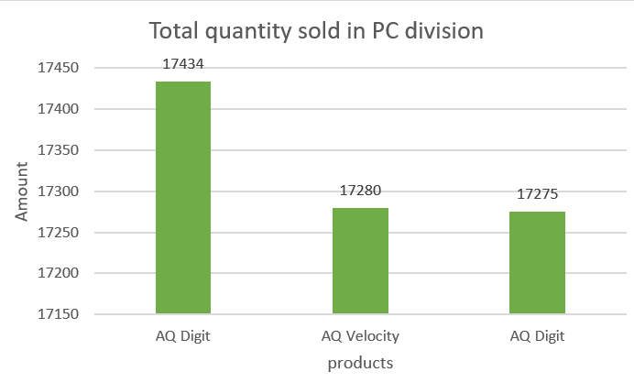
Conversion of output to visual
Insights
In personal computers division AQ digit had the highest quantity sold.

